Slide 1
Deceptive Content Analysis
Utkarsh Midha, Ujjwal Kumar, Tripti Saloni
Department of Computer Science and Engineering,
KIET Group of Institutions, Ghaziabad, India

Slide 2

Introduction
Fake news has become a significant concern in today's digital age, where information spreads rapidly across various platforms.
The proliferation of fake news poses serious consequences, including misinformation, public manipulation, and erosion of trust in media sources.
Therefore, the development of reliable and accurate fake news detection methods is crucial in combating this issue.
In this research, we propose a novel approach for fake news detection utilizing the power of Long Short-Term Memory (LSTM) and Natural Language Processing (NLP) techniques.
Our study aims to contribute to the advancement of automated fake news detection systems, enabling the identification of deceptive information with high accuracy.
By leveraging LSTM, a type of recurrent neural network known for its ability to capture sequential dependencies, combined with NLP techniques, we strive to improve the effectiveness of fake news detection models.
The outcomes of this research have the potential to enhance the credibility of news sources, empower users to make informed decisions, and mitigate the adverse impacts of fake news on society.

Slide 3


Methodology
Our methodology consists of the following steps:
Data Collection:
Collected a diverse dataset of news articles from reputable sources.
Data Preprocessing:
Cleaned the dataset by removing stopwords, did stemming and lemmatization
Converted text data into numerical representations suitable for LSTM and NLP.
LSTM Model Architecture:
Utilized LSTM, a recurrent neural network, to capture temporal dependencies in text data.
Constructed the model with multiple layers.
Training and Evaluation:
Split the dataset into training and testing sets.
Trained the LSTM model using sequential model.
Evaluated the model's performance using accuracy, precision, recall, and F1-score.
Results and Analysis:
Compared the LSTM model with baselines and existing approaches.
Analyzed results using statistical methods and visualizations.
Derived insights and made recommendations for future improvements.

Slide 4
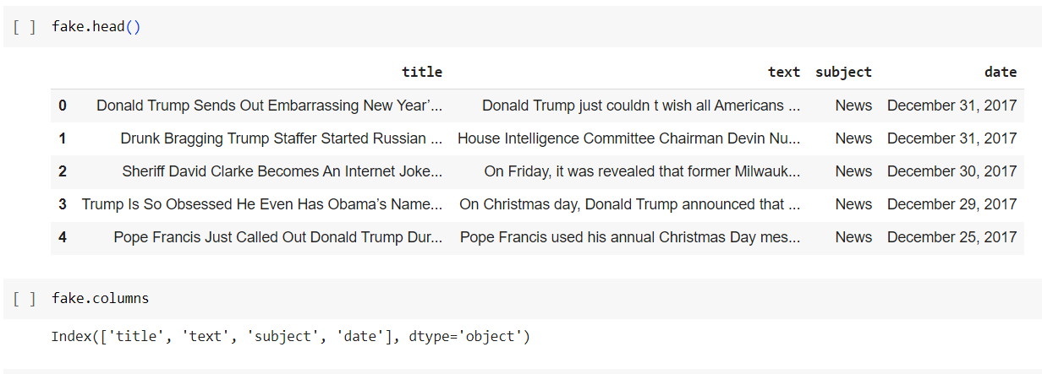
Dataset
Dataset Description:
The dataset used in this research consists of two files: "fake.csv" and "true.csv."
Each file contains information about news articles categorized as either fake or true.
The dataset was collected for the purpose of fake news detection using LSTM and NLP techniques.
File: "fake.csv"
Contains articles categorized as fake news.
Columns:
Title: The title of the article.
Text: The main text content of the article.
Subject: The subject or topic of the article.
Date: The date at which the article was posted.
File: "true.csv"
Contains articles categorized as true news.
Columns:
Title: The title of the article.
Text: The main text content of the article.
Subject: The subject or topic of the article.
Date: The date at which the article was posted.
Dataset Size and Characteristics:
The combined dataset consists of a total of 44919 articles.
The "fake.csv" file contains 23502 fake news articles.
The "true.csv" file contains 21417 true news articles.
The dataset encompasses a diverse range of subjects and dates to capture various aspects of fake and true news.

Slide 5
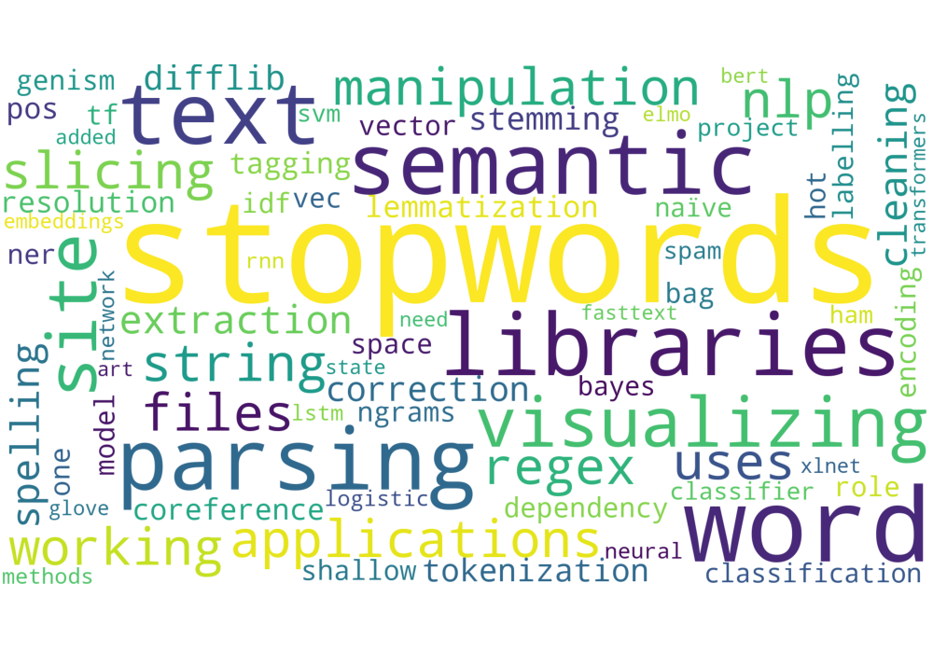

Data Preprocessing
In the context of fake news detection using LSTM and NLP, data preprocessing plays a crucial role in preparing the dataset for analysis. The following techniques were applied to preprocess the data:
Removing Stopwords, Special Characters, and Empty Values:
Stopwords, such as "and," "the," and "is," do not carry significant meaning and can be safely removed to reduce noise in the dataset.
Special characters, such as punctuation marks and symbols, were also removed to ensure that only relevant text remains for analysis.
Empty or missing values were identified and either dropped or imputed based on the specific requirements of the dataset.
Labeling and Forming a Single Dataset for Real and Fake News:
To train the LSTM model, it is essential to have labeled data. Real news and fake news articles were assigned appropriate labels (e.g., 1 for real news, 0 for fake news).
Real and fake news datasets were combined into a single dataset to create a balanced training set, ensuring equal representation of both classes.
Stemming:
Stemming is a technique used to reduce words to their base or root form by removing suffixes.
It helps to normalize the dataset by considering different forms of the same word as a single entity.
For example, stemming converts "running," "runs," and "ran" to the base form "run."

Slide 6
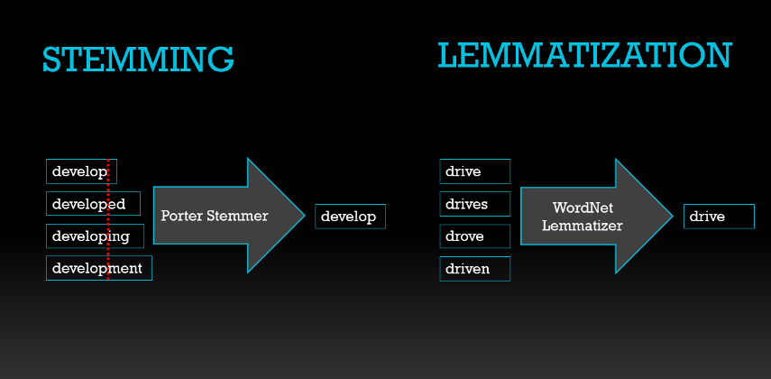
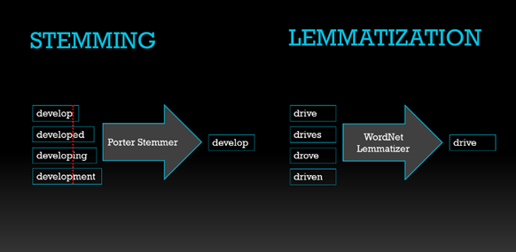
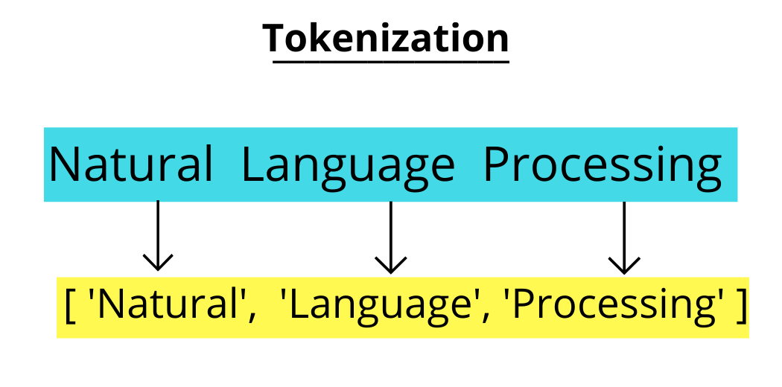
Data Preprocessing
Lemmatization:
Lemmatization is like stemming but produces meaningful words rather than just removing suffixes.
It reduces words to their lemma or base form using vocabulary and morphological analysis.
For example, lemmatization converts "running," "runs," and "ran" to the lemma "run."
Tokenization:
Tokenization is the process of breaking down text into individual words or tokens.
It facilitates the conversion of unstructured text data into a structured format suitable for further analysis.
Tokens can be created by splitting text based on spaces or using more advanced techniques, such as word embeddings or n-grams.
By applying these preprocessing techniques, we obtained a clean and structured dataset that is suitable for training and evaluating the LSTM model for fake news detection. Preprocessing the data in this manner helps to improve the model's ability to learn meaningful patterns and make accurate predictions

Slide 7
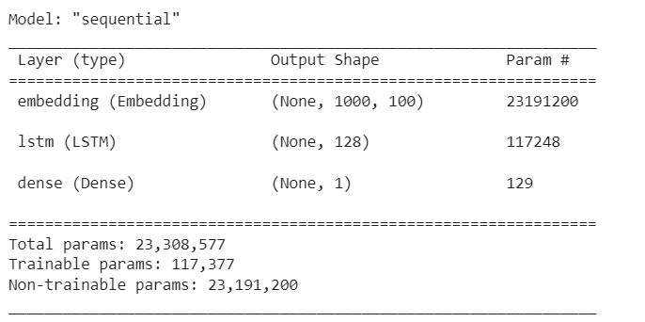
Training and Evaluation
For LSTM
Training Process:
The LSTM model was trained using the Adam optimizer and binary cross-entropy loss function.
The model was compiled with the following settings: optimizer='adam', loss='binary_crossentropy', metrics=['acc'].
The embedding layer of the model was initialized with pre-trained word vectors.
The embedding layer weights were set to non-trainable, which means that the word vectors were not updated during training.
The LSTM layer consisted of 128 units to capture the temporal dependencies in the text data.
The final dense layer used the sigmoid activation function, suitable for binary classification tasks.
Model Summary:
The model consisted of three main layers: embedding, LSTM, and dense.
The embedding layer received input of shape (None, 1000, 100), where None represents the batch size, 1000 represents the maximum length of input sequences, and 100 represents the dimensionality of the word vectors.
The embedding layer had a total of 23,191,200 non-trainable parameters, as the pre-trained word vectors were used and kept fixed during training.
The LSTM layer had 117,248 parameters, allowing the model to capture the sequential information in the text.
The dense layer had 1 output unit, representing the binary classification output, and it used the sigmoid activation function.
The model had a total of 23,308,577 parameters, with 117,377 trainable parameters.

Slide 8
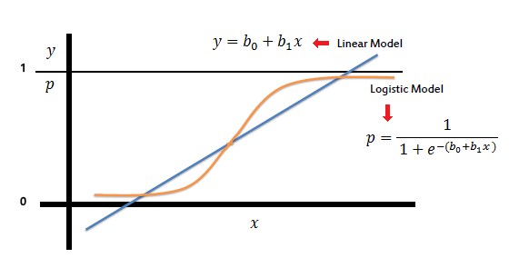
Training and Evaluation
For Logistic Regression
Training Process:
The Logistic Regression model was trained using a vectorization method.
The text data was preprocessed and transformed into numerical feature vectors using a vectorization technique such as TF-IDF or Bag-of-Words.
The transformed feature vectors were used as input to train the Logistic Regression model.
The model was trained using a suitable optimization algorithm, such as gradient descent, to find the optimal weights for the logistic regression equation.
The training process aimed to minimize the logistic loss function and maximize the likelihood of correct classification.
Model Summary:
The Logistic Regression model was based on the logistic regression equation, which models the probability of a binary outcome.
The model did not involve complex layers or deep learning architectures like neural networks.
It utilized the feature vectors derived from the vectorization method as input variables for the logistic regression equation.
The model estimated the coefficients for each feature variable and an intercept term.
The logistic regression equation mapped the input feature vectors to a probability score, indicating the likelihood of belonging to a specific class.

Slide 9
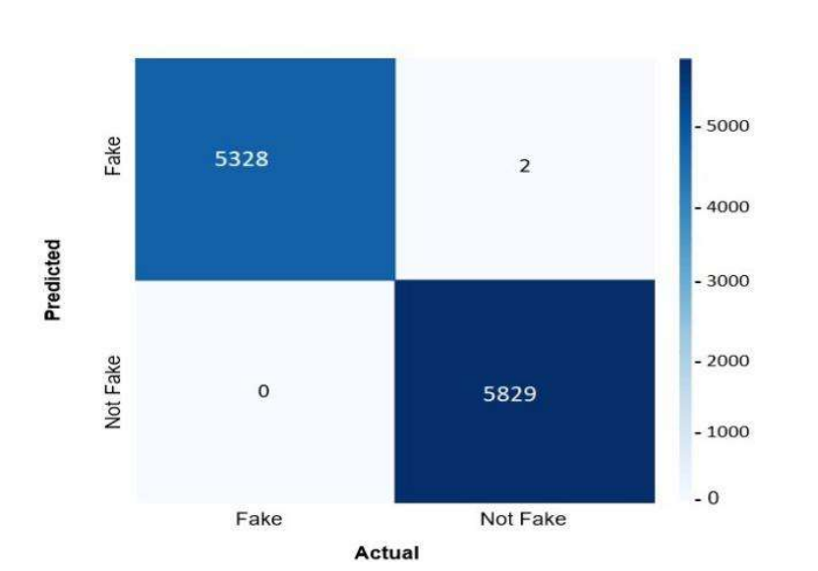
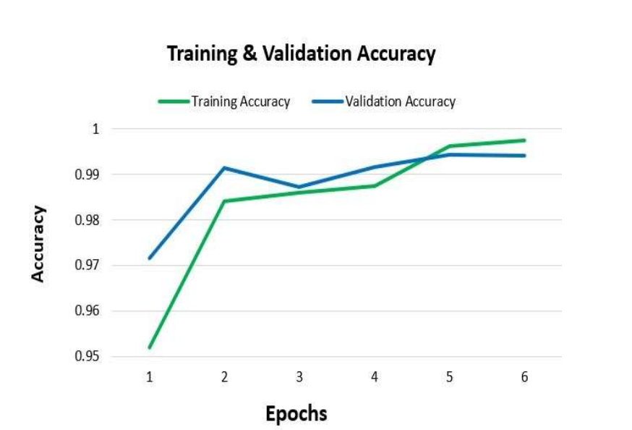
Results
Our research involved evaluating the performance of both the Logistic Regression model and the LSTM model for fake news detection. Here are the results and analysis of our experiments:
Logistic Regression Model:
The Logistic Regression model achieved an impressive accuracy of 99.98%.
When we input news text into the interface, the model correctly identified the news as either fake or real in the majority of cases.
To test the model's ability to detect fake news, we used news articles from The Onion, a satire 'news' portal known for publishing fake funny news. The model successfully identified these articles as fake.
Additionally, we tested the model with news articles from reputable sources like BBC and New York Times, and it correctly classified them as real news.
Based on these findings, we can conclude that the Logistic Regression model demonstrates high accuracy in detecting fake news.
LSTM Model:
The LSTM model achieved an accuracy of 99.28%.
While the accuracy is still impressive, it is slightly lower than that of the Logistic Regression model.
The LSTM model's performance in correctly identifying fake news from The Onion was comparable to the Logistic Regression model.
However, when tested with news articles from BBC and New York Times, the LSTM model also correctly classified them as real news.
In comparison to the Logistic Regression model, the LSTM model exhibited slightly lower accuracy in fake news detection.

Slide 10
Conclusion and Future Scope
Conclusion
Our project can ring the initial alert for fake news.
The model produces worse results if the article is written cleverly, without any sensationalization.
This is a very complex problem but we tried to address it as much as we could.
We believe the interface provides an easier way for the average person to check the authenticity of a news.
Projects like this one with more advanced features should be integrated on social media to prevent the spread of fake news.
Future Scope
There are many future improvement aspects of this project.
Introducing a cross checking feature on the machine learning model so it compares the news inputs with the reputable news sources is one way to go.
It has to be online and done in real time, which will be very challenging.
Improving the model accuracy using bigger and better datasets, integrating different machine learning algorithms is also something we hope to do in the future.

Slide 11

Questions and Discussion
How reliable is the LSTM model in detecting fake news compared to other existing methods?
The LSTM model has shown promising results in detecting fake news, outperforming some traditional methods. However, the reliability may vary depending on the dataset and specific implementation.
What are the key features or factors that contribute to the accurate detection of fake news using LSTM and NLP?
Key features include linguistic patterns, sentiment analysis, contextual cues, and semantic meaning extracted through NLP techniques. The LSTM model effectively captures long-term dependencies and context, enabling accurate detection.
How scalable is the proposed LSTM-based approach for detecting fake news?
The scalability of the LSTM-based approach depends on factors such as dataset size, computational resources, and optimization techniques. It can be scaled up to handle larger datasets and real-time scenarios with proper considerations.
Are there any ethical implications or challenges associated with fake news detection using LSTM and NLP?
Yes, there are ethical implications such as potential biases and unintended consequences in decision-making. Ensuring transparency, fairness, and addressing bias in data and model design is crucial to mitigate such challenges.
What are the potential applications and real-world implications of your research?
The research findings have applications in combating fake news across various domains, including social media platforms, news organizations, and political campaigns. The LSTM-based approach can enhance existing news verification systems.
How can your research be extended or improved upon in the future?
Future research can explore incorporating additional linguistic features, leveraging external knowledge sources, and exploring ensemble methods. Addressing domain-specific challenges and evaluating the model's performance on diverse datasets would also be valuable.
Feel free to ask any additional questions you may have about our research

Slide 12
THANK YOU

